Slide 1
Lecture 17
Modern Programming Trends
JVM, C#, .NET
Programming Language Concepts

Slide 2

From Source Code to Executable Code
program gcd(input, output);
var i, j: integer;
begin
read(i, j);
while i <> j do
if i > j then i := i – j;
else j := j – i;
writeln(i)
end.
Compilation
Notes:
Compiler translate high-level source program intro an equivalent target program

Slide 3
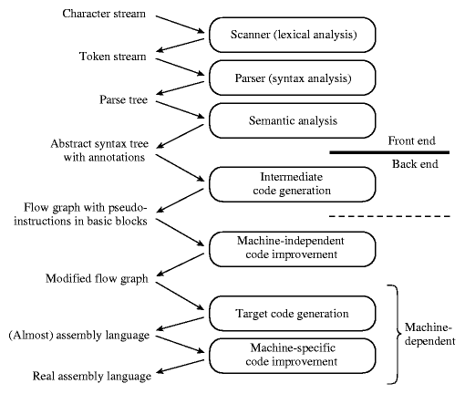
Phases of Compilation
The first three phases are language-dependent
The last two are machine-dependent
The middle two dependent on neither the language nor the machine

Slide 4
Example
program gcd(input, output);
var i, j: integer;
begin
read(i, j);
while i <> j do
if i > j then i := i – j;
else j := j – i;
writeln(i)
end.

Slide 5
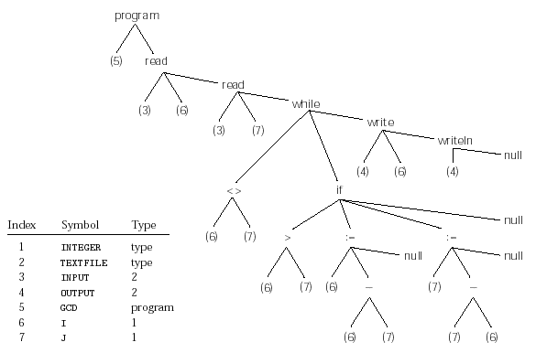
Example
Syntax Tree and Symbol Table

Slide 6
Phases of Compilation
Intermediate code generation transforms the abstract syntax tree into a less hierarchical representation: a control flow graph

Slide 7
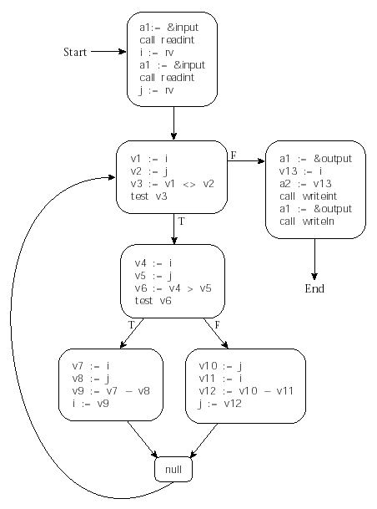
Example
Control Flow Graph
Basic blocks are maximal-length set of sequential operations
  Operations on a set of virtual registers
    Unlimited
    A new one for each computed value
Arc represents interblock control flow

Slide 8
Phases of Compilation
Machine-independent code improvement performs a number of transformations:
  Eliminate redundant loads stores and arithmetic computations
  Eliminate redundancies across blocks

Slide 9
Phases of Compilation
Target Code Generation translates blocks into the instruction set of the target machine, including branches for the arc
It still relies in the set of virtual registers

Slide 10
Phases of Compilation
Machine-specific code improvement consists of:
  Register allocation (mapping of virtual register to physical registers and multiplexing)
  Instruction scheduling

Slide 11
Compilation Passes
Why are compilers divided in passes?
Sharing the front-end among the compilers of more than one machine
Sharing the back-end among the compilers of more than one language
Historically, passes help reducing memory usage

Slide 12
Intermediate Forms
Front-end and back-end are linked using an abstract representation known as the Intermediate Format (IF)
They classified according to their level of machine dependence
High-level IFs are usually trees or directed graphs that capture the hierarchy of the program
  They are useful for machine-independent code improvement, interpretation and other operations

Slide 13
Intermediate Forms
Stack-based Language
Stack-based language are another type of IFs
  E.g. JVM, Pascal’s P-code
They are simple and compact
  They resemble post-order tree enumeration
Operations
  Take their operands from an implicit stack
  Return their result to an implicit stack
These languages tend to make language easy to port and the result code is very compact
  Ideal for network transfer of applets

Slide 14
The Java Virtual Machine
Java Architecture
  Java Programming Language
  Java Virtual Machine (JVM)
  Java API
We will use the JVM as a case study of an intermediate program representation

Slide 15
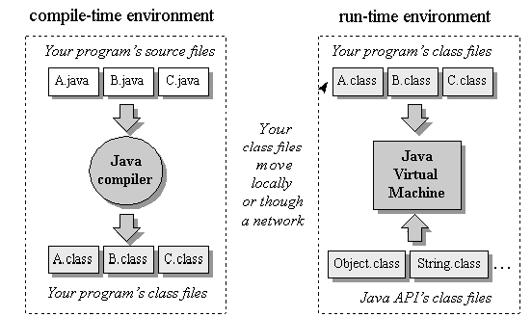
The Java Programming Environment

Slide 16
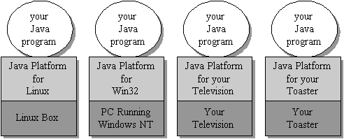
The Java Platform
The byte code generated by the Java front-end is an intermediate form
  Compact and Platform-independent

Slide 17
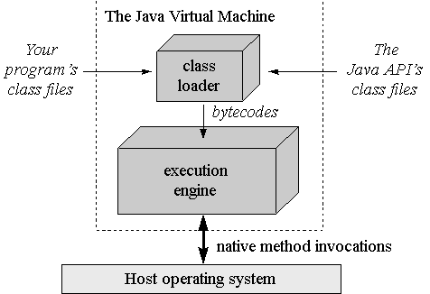
The Role of the Virtual Machine
Local or
Remote

Slide 18
Dynamic Class Loading
You don't have to know at compile-time all the classes that may ultimately take part in a running Java application.
User-defined class loaders enable you to dynamically extend a Java app at run-time
As it runs, your app can determine what extra classes it needs and load them
Custom loaders can download classes across a network (applets), get them out of some kind of database, or even calculate them on the fly.

Slide 19
The Execution Engine
Back-end transformation and execution
  Simple JVM: byte code interpretation
  Just-in-time compiler
    Method byte codes are compiled into machine code the first time they are invoked
    The machine code is cached for subsequent invocation
    It requires more memory
  Adaptive optimization
    The interpreter monitors the activity of the program, compiling the heavily used part of the program into machine code
    It is much faster than simple interpretation

Slide 20
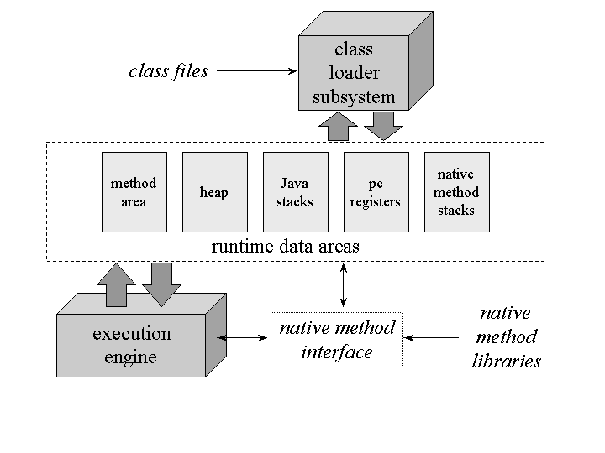
The Java Virtual Machine

Slide 21
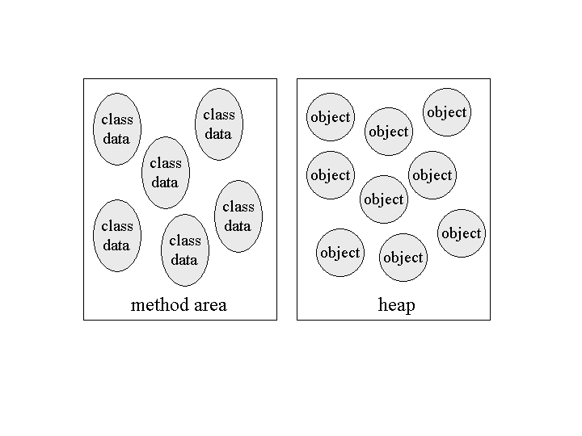
Shared Data Areas
Each JVM has one of each:
Method area: byte code and class (static) data storage
Heap: object storage

Slide 22
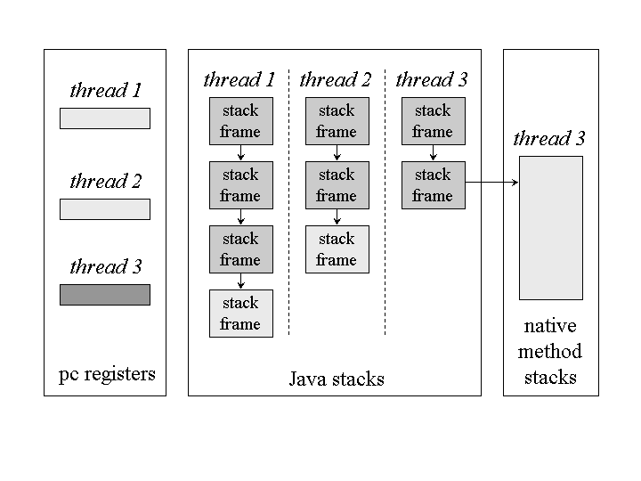
Thread Data Areas
Frame in Execution

Slide 23
Stack Frames
Stack frames have three parts:
  Local variables
  Operand stack
  Frame data

Slide 24
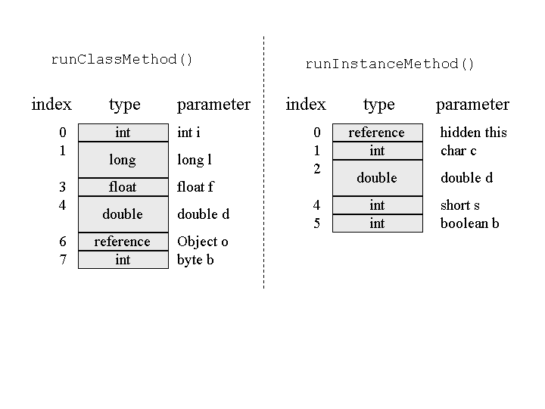
Stack Frame
Local Variables
class Example {
public static int runClassMethod(int i, long l, float f, double d, Object o, byte b) {
return 0;
}
public int runInstanceMethod(char c, double d, short s, boolean b) {
return 0;
}
}

Slide 25
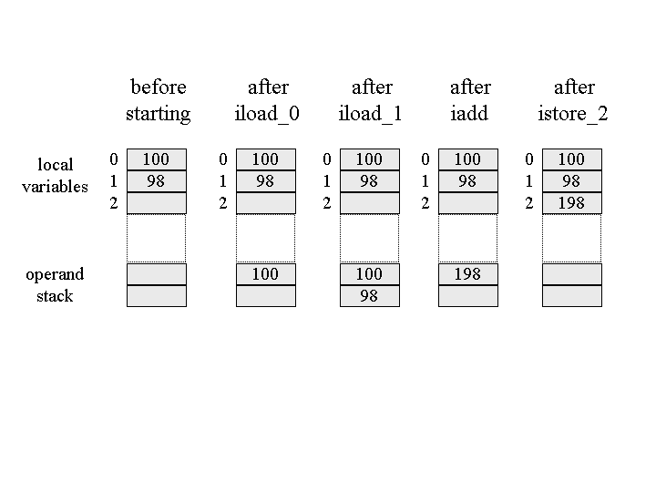
Stack Frame
Operand Stack
Adding 2 numbers
iload_0
iload_1
Iadd
istore_2

Slide 26
Stack Frame
Frame Data
The stack frame also supports
  Constant pool resolution
  Normal method return
  Exception dispatch

Slide 27
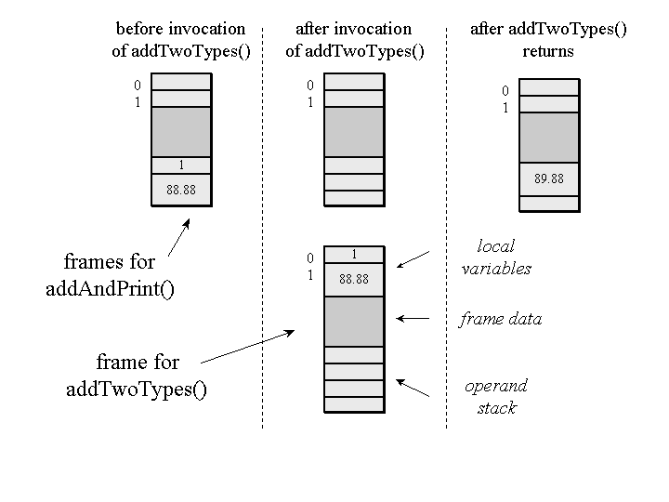
Stack Frame
Frame Allocation in a Heap
class Example {
public static void addAndPrint() {
double result = addTwoTypes(1, 88.88);
System.out.println(result);
}
public static double addTwoTypes(int i, double d) {
return i + d;
}
}

Slide 28
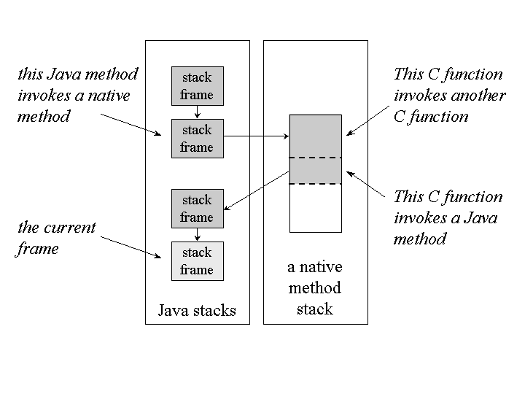
Stack Frame
Native Method
A simulated stack of the target language (e.g. C) is compared.

Slide 29
The Heap
Class instances and array are stores in a single, shared heap
Each Java application has its own heap
  Isolation
  But a JVM crash will break this isolation
JVM heaps always implement garbage collection mechanisms

Slide 30
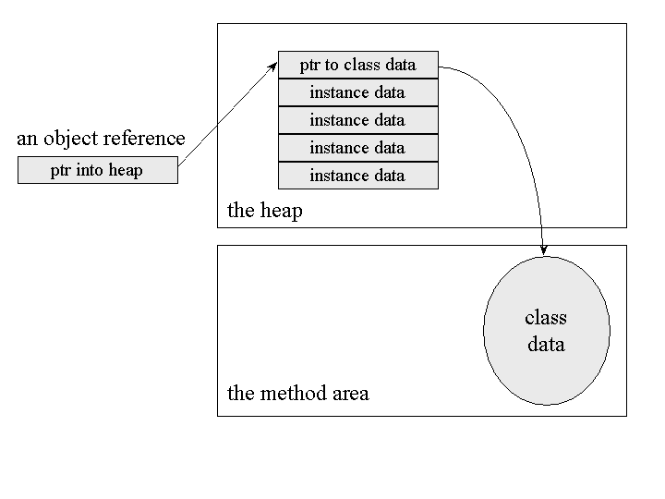
Heap
Object Representation

Slide 31
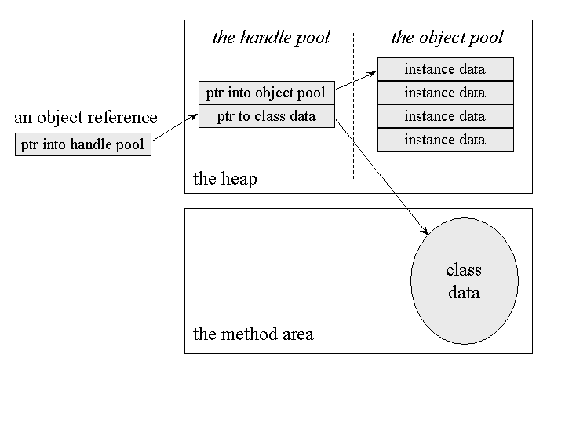
The Heap
Object Representation

Slide 32
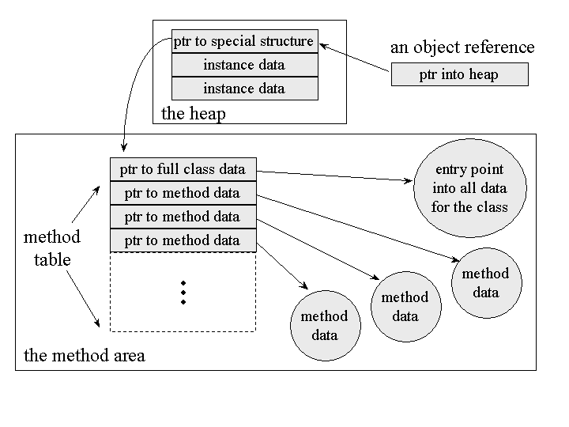
The Heap
Memory/Speed Tradeoff

Slide 33
Reference
The content of this lecture is based on Inside the Java 2 Virtual Machine by Bill Venners
  Chapter 1 Introduction to Java's Architecture
    http://www.artima.com/insidejvm/ed2/introarchP.html
  Chapter 5 The Java Virtual Machine
    http://www.artima.com/insidejvm/ed2/jvm.html
  Interactive Illustrations
    http://www.artima.com/insidejvm/applets/index.html

Slide 34
C# and .NET
In 2000, Microsoft releases a new language, C#, heavily influences by Java and C++
  Is there anything new from the programming languages point of view?
Microsoft is making it the key stone in their new development strategy (.NET)
  Big bucks… big evil…

Slide 35
Hello World
Java
C#
public class HelloWorld {
public static void main(String[] args) {
System.out.println(“Hello world!");
}
}
class HelloWorld {
static void Main(string[] args) {
System.Console.WriteLine(“Hello world!");
}
}

Slide 36
Motivation for C#
.NET
  New development framework that promises to simplify Windows programming
    COM/DCOM is hard to learn
  Heavy on component orientation
  Language independence run-time system
    Common Language Run-time (CLR)
C# programs
VB .NET
Framework Class Libraries
Common Language Runtime
Windows

Slide 37
Common Language Runtime
It can execute .NET program in an intermediate representation, the Common Language Interface (CLI)
CLR is designed to work well in a multi-language environment
  Java Virtual Machines is rather Java-oriented
  CLR is supposed to work well with imperative programming languages (e.g., C, Pascal) and statically typed object oriented languages (e.g., C#, Eiffel)
  Many language have compilers for CLR at different stages of development, including Python, Perl, Scheme, Haskell, Prolog,…

Slide 38
Motivation for C#
Rapid application development (RAD)
  Visual development tools/languages such as Visual Basic and Delphi, are very popular and useful
  C# is optimized for such development model
Platform-independence
  CLR and CLI
Access to platform-native resources
  A more direct approach than the one taken by Java Native Interface (JNI)

Slide 39
C# Syntax
Comparison with Java
If/then/else
Java
C#
int i = 0;
if (i == 0) {
i = 1;
} else {
i = 2;
}
int i = 0;
if (i == 0) {
i = 1;
} else {
i = 2;
}

Slide 40
C# Syntax
Switch
Java
C#
int i = 0;
switch (i) {
case 0:
i = 1;
break;
case 1:
i = 2;
break;
default:
i = -1;
break;
}
int i = 0;
switch (i) {
case 0:
i = 1;
break;
case 1:
i = 2;
break;
default:
i = -1;
break;
}

Slide 41
C# Syntax
While
Do/While
Java
C#
int i = 0;
while (i++ < 10) {
}
int i = 0;
while (i++ < 10) {
}
Java
C#
int i = 0;
do {
} while (i++ < 10);
int i = 0;
do {
} while (i++ < 10);

Slide 42
C# Syntax foreach
Java
import java.util.Vector;
public static int sum(Vector v) {
int sum = 0;
for (int j = 0; j < v.size(); j++) {
Integer i = (Integer)v.elementAt(j);
sum = sum + i.intValue();
}
return sum;
}
C#
using System.Collections;
static int SumList(ArrayList theList) {
int sum = 0;
foreach (int j in theList) {
sum = sum + j;
}
return sum;
}

Slide 43
C# Syntax
Break/Continue
Return
Java
C#
int i = 0;
while (i++ < 10) {
if (i < 5) continue;
break;
}
int i = 0;
while (i++ < 10) {
if (i < 5) continue;
break;
}
public void returnNothing() {
return;
}
public int returnOne() {
return 1;
}
public void returnNothing() {
return;
}
public int returnOne() {
return 1;
}

Slide 44
C# Syntax
Object instantiation
Exclusive access
Java
C#
Something s =
new Something();
Something s =
new Something();
synchronized(this) {
// do something
}
lock(this) {
// do something
}

Slide 45
C# Syntax try/catch/finally
Java
try {
throw new SampleException();
} catch (SampleException ex) {
} finally {
}
C#
try {
throw new SampleException();
} catch (SampleException ex) {
} finally {
}
try {
throw new SampleException();
} catch {} finally {
}
catch clause is optional
catch argument is optional
No throws keyword

Slide 46
C# Syntax
Class definition
Interface definition
Interface implementation
Java
C#
class Foo extends Bar {
...
}
class Foo extends Bar {
...
}
interface IFoo extends IBar {
...
}
interface IFoo : IBar {
...
}
class Foo implements IFoo, IBaz {
...
}
class Bar: IFoo, IBaz {
}

Slide 47
Other C# Features
C# provides Java-style garbage collection
C# implements a Java- and Delphi-style value/reference-type system
  Variables of primitive types also act like objects (unlike Java primitive objects)
Java
  Integer iobj = new Integer(12);
  System.out.println(iobj.toString());
C#
Console.WriteLine(12.ToString());

Slide 48
Other C# Features
Enumerations
enum description: ulong {
Good,
Bad,
Ugly
};
Properties (forced getter and setters)
TextBlock tb;
if (tb.backgroundColor == Color.green) {
// "get" is called for comparison
tb.backgroundColor = Color.red; // "set" is called
} else {
tb.backgroundColor = Color.blue; // "set“ is called
}

Slide 49
Other C# Features
Get/set
public class TextBlock {
// Assume Color is an enum
private Color _bgColor;
private Color _fgColor;
public Color backgroundColor {
get {
return _bgColor;
}
set {
_bgColor = value;
}
//... and so on...
}
}

Slide 50
End of Lecture

